Slide 1
Diagnostic and Therapeutic Devices Case Study: Diabetes

Slide 2
What is diabetes?
Diabetes mellitus (DM) is a group of diseases characterized by high levels of blood glucose resulting from defects in insulin production, insulin action, or both.
The term diabetes mellitus describes a metabolic disorder of multiple aetiology characterized by chronic hyperglycaemia with disturbances of carbohydrate, fat and protein metabolism resulting from defects in insulin secretion, insulin action, or both.
The effects of diabetes mellitus include long–term damage, dysfunction and failure of various organs.

Slide 3
Diabetes Long-term effects
Diabetes mellitus may present with characteristic symptoms such as thirst, polyuria, blurring of vision, and weight loss.
The long–term effects of diabetes mellitus include progressive development of the specific complications of retinopathy with potential blindness, nephropathy that may lead to renal failure, and/or neuropathy with risk of foot ulcers, amputation
People with diabetes are at increased risk of cardiovascular, peripheral vascular and cerebrovascular disease.

Slide 4
Burden of Diabetes
The development of diabetes is projected to reach pandemic proportions over the next10-20 years.
International Diabetes Federation (IDF) data indicate that by the year 2035, the number of people affected will reach 500 million –90% of these people will have Type 2 diabetes.
In India, there are 65 million diabetics and it is growing at an alarming rate
The annual health costs caused by diabetes and its complications account for around 6-12% of all health-care expenditure.

Slide 5
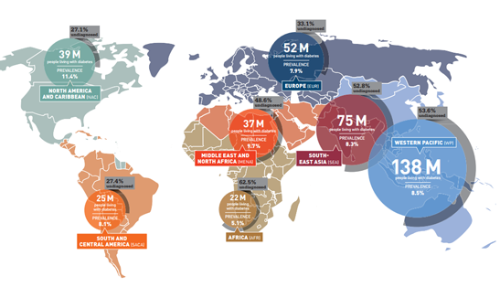

Slide 6
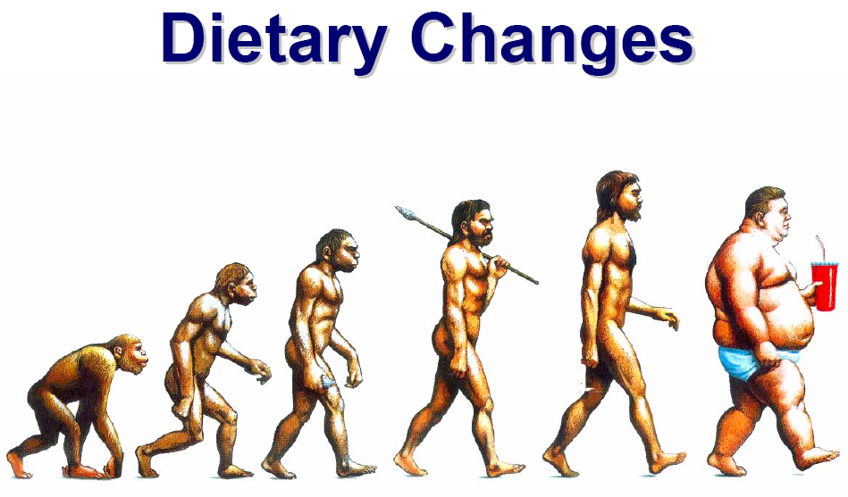

Slide 7
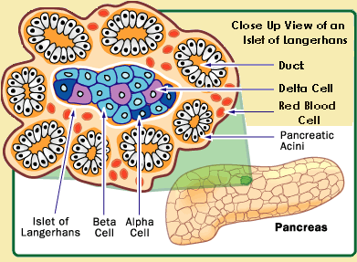
Pancreas
The pancreas is a glandular organ in the digestive system and endocrine system of vertebrates. In humans, it is located in the abdominal cavity behind the stomach. It is an endocrine gland producing several important hormones, including insulin, glucagon, somatostatin, and pancreatic polypeptide which circulate in the blood. The pancreas is also a digestive organ, secreting pancreatic juice containing digestive enzymes that assist digestion and absorption of nutrients in the small intestine. These enzymes help to further break down the carbohydrates, proteins, and lipids.
Endocrine glands are glands of the endocrine system that secrete their products, hormones, directly into the blood rather than through a duct.

Slide 8
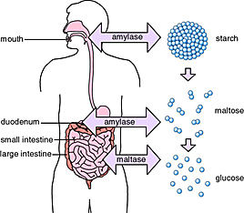
Carbohydrate Digestion
The complex polysaccharide starch is broken down into glucose by the enzymes amylase and maltase (secreted by the small intestine).

Slide 9
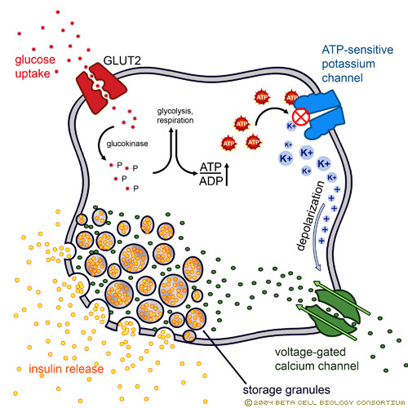
Insulin Secretion
The process by which insulin is released from beta cells, in response to changes in blood glucose concentration, Type 2 glucose transporters (GLUT2) mediate the entry of glucose into beta cells (see panel). As the raw fuel for glycolysis, the universal energy-producing pathway, glucose is phosphorylated by the rate-limiting enzyme glucokinase. This modified glucose becomes effectively trapped within the beta cells which triggers export of the insulin-storing granules by a process known as exocytosis. The ultimate result is the export of insulin from beta cells and its diffusion into nearby blood vessels. Extensive vascular capacity of surrounding pancreatic islets ensures the prompt diffusion of insulin (and glucose) between beta cells and blood vessels.
Insulin release is a biphasic process. The initial amount of insulin released upon glucose absorption is dependent on the amounts available in storage. Once depleted, a second phase of insulin release is initiated. This latter release is prolonged since insulin has to be synthesized, processed, and secreted for the duration of the increase of blood glucose. Furthermore, beta cells also have to regenerate the stores of insulin initially depleted in the fast response phase

Slide 10
Insulin is the key…
…that “unlocks” the body’s cells so glucose can enter the cells and be burned for energy.
Without insulin,the body’s cells can’t burn
glucose for energy and sugar accumulates in the blood.

Slide 11
Types of Diabetes
Type 1 Diabetes Mellitus
Type 2 Diabetes Mellitus
Gestational Diabetes

Slide 12
Type 1 diabetes
Was previously called insulin-dependent diabetes mellitus (IDDM) or juvenile-onset diabetes.
Type 1 diabetes develops when the body’s immune system destroys pancreatic beta cells, the only cells in the body that make the hormone insulin that regulates blood glucose.
This form of diabetes usually strikes children and young adults, although disease onset can occur at any age.
Type 1 diabetes may account for 5% to 10% of all diagnosed cases of diabetes.
Risk factors for type 1 diabetes may include autoimmune, genetic, and environmental factors.

Slide 13
Type 2 diabetes
Was previously called non-insulin-dependent diabetes mellitus (NIDDM) or adult-onset diabetes.
Type 2 diabetes may account for about 90% to 95% of all diagnosed cases of diabetes.
It usually begins as insulin resistance, a disorder in which the cells do not use insulin properly. As the need for insulin rises, the pancreas gradually loses its ability to produce insulin.
Type 2 diabetes is associated with older age, obesity, family history of diabetes, history of gestational diabetes, impaired glucose metabolism, physical inactivity, and race/ethnicity.
Type 2 diabetes is increasingly being diagnosed in children and adolescents.

Slide 14
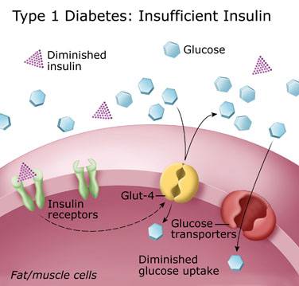
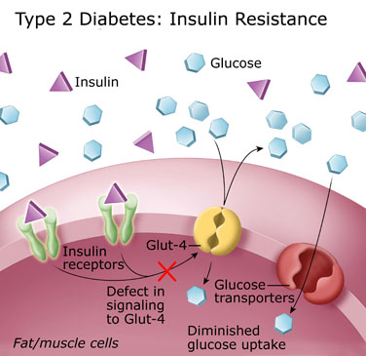

Slide 15
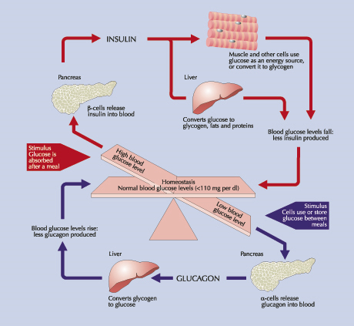

Slide 16
Gestational diabetes
A form of glucose intolerance that is diagnosed in some women during pregnancy.
Gestational diabetes occurs more frequently among African Americans, Hispanic/Latino Americans and Indians. It is also more common among obese women and women with a family history of diabetes.
During pregnancy, gestational diabetes requires treatment to normalize maternal blood glucose levels to avoid complications in the infant.
After pregnancy, 5% to 10% of women with gestational diabetes are found to have type 2 diabetes.
Women who have had gestational diabetes have a 20% to 50% chance of developing diabetes in the next 5-10 years.

Slide 17
Balancing Good Glycemic Control with a Low Risk of Hypoglycemia…
Glycemic control
Hypoglycemia
Essentially, the key to good insulin therapy is to balance good glycemic control with a low risk of hypoglycemia.
Notes:
17
Key Point
Essentially, the key to good insulin therapy is to balance good glycemic control with a low risk of hypoglycemia.

Slide 18
Diagnosis
Fasting plasma glucose > 126 mg/dl
Random plasma glucose > 200 mg/dl plus symptoms
Two hour OGTT (oral glucose tolerance test) level > 200 mg/dl using a glucose load of 75 g (normal < 140 mg/dl)
Normal fasting 70-125 mg/dl, after meals < 180 mg/dl

Slide 19
Why Glucose Sensing??
More “real time” assessment
Ability to detect hypoglycemia and hyperglycemia at “odd” times
Better administration and correlation of insulin dosages—less guessing
May uncover eating disorders and other issues related to stress, diet and exercise
Patient compliance with monitoring an issue– many do not like to “poke” fingers or other sites so often. Pain and discomfort, lack of blood obtained, lost strips, etc.

Slide 20
Why Glucose Sensing??
Goal– Closing the Loop
An artificial pancreas
Provide accurate and specific data to control glucose levels – many individuals keep blood glucoses higher than optimal to avoid hypoglycemia
Fear of hypoglycemia in the middle of the night– not waking up
“Take the worry” out of diabetes treatment – Type 1 patients in particular; parents, children and physicians

Slide 21
Optimal Conditions for Glucose Measurement
Immediate availability of results and measurements
High frequency of measurements
Measurements every 2-5 minutes would be ideal
Ability to detect rapid rise or decline is necessity
Need quick signal stability after initiation or placement
Stability over prolonged period of time (>3 days necessary)

Slide 22
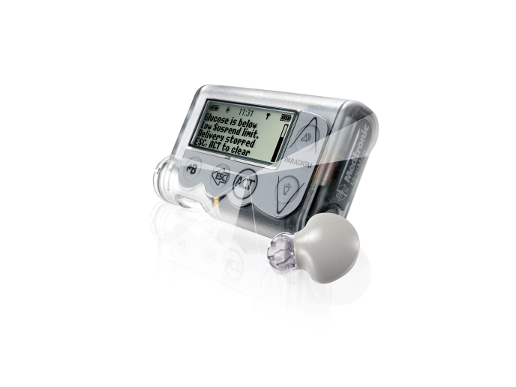
MiniMed Paradigm® Veo™ System A new era in diabetes management
First CGM-ready insulin pump with automatic insulin shut-off mechanism
Medtronic Confidential – June 2009

Slide 23
Is Hypoglycaemia a Clinical Challenge?
Do some patients suffer from:
Hypoglycaemia Unawareness?
Nocturnal Hypoglycaemia?
Or a fear of Hypoglycaemia?

Slide 24
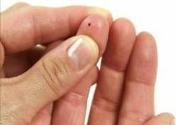
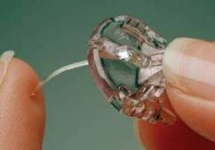
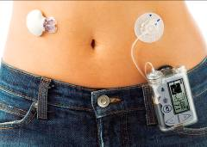
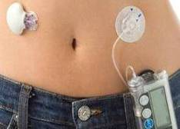


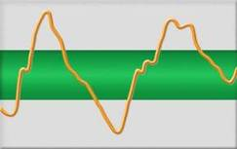





Why Is Continuous Glucose Monitoring in Diabetes So Important?
Finger stick testing with meter/strip
Continuous sensing
Continuous sensing with alerts
CGM completes the fingerstick picture. The use of alerts allow early patient intervention to reduce the severity and duration of highs and lows

Slide 25
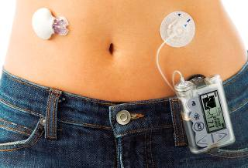
MiniMed Paradigm® Veo™ System A new era in diabetes management
Closing the loop
First device to offer sensor-driven adjustments to insulin delivery
Greater protection from severe hypoglycaemia
Automatic insulin shut-off mechanism –
Low Glucose Suspend (LGS)
Greater protection from glycaemic excursions
CGM-ready insulin pump
CGM alerts
Give early warnings of glycemic excursions
Reduce the duration of hypoglycemic excursions²
Improved sensor sensitivity in the hypoglycaemic range
1. Pickup JC, Sutton AJ. Severe hypoglycaemia and glycaemic control in Type 1 diabetes: meta-analysis of multiple daily injections compared with continuous subcutaneous insulin infusion. Diabet Med. 2008;25:765-774
2. Bode B., et al. Diabetes Technology and Therapeutics. Volume 6, Number 2, 2004

Slide 26
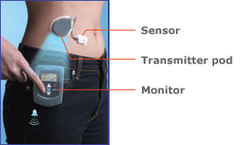
Modified Home Use of CGMS—Guardian System

Slide 27
Guardian Home System
Sensor can be set to “alarm” at certain levels both high and low
Monitor can be placed up to 6 feet away; does not have to be worn
Monitor can store up to 21 days of data
Can be downloaded to personal computer
Still needs calibration similar to CGMS system
Alerts or alarms need to be verified with “finger stick” glucose
Cost is not set at present (~ $800- $1500 anticipated)

Slide 28
Implantable Subcutaneous Systems
Enzyme electrode system
Electrochemical device

Slide 29
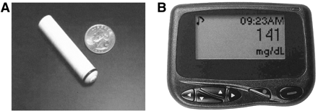
DexCom Subcutaneous Sensor System
Implantable Sensor device
Pager monitoring system

Slide 30
DexCom Subcutaneous Sensor System
Special bioprotective layer prevents foreign body reaction with sensor
Can measure glucose ranging from 40 mg/dl to 700 mg/dl (2.2-38.9 mmol/L)
Recalibration every 20 days
160 – 180 day lifespan for sensor
Still need to do HGM 2-3 times/day to initiate glucose algorithm
Easily implanted in subcutaneous tissue
Can be accomplished as outpatient procedure
Diabetes Care 27:734, 2004
Endocrinology Clinics NA 33:175, 2004

Slide 31

Therasense Navigator System
Interstitial System
Wireless system
Needs calibration 1-2 times per day
Readings every 1-2 minutes conceptualized
High and low glucose alarms to be incorporated
Currently experimental
Withdrawn from trials

Slide 32
Open-flow Microperfusion Systems
ADICOL Project-Disetronic/Roche
Advanced Insulin Infusion with a Control Loop

Slide 33
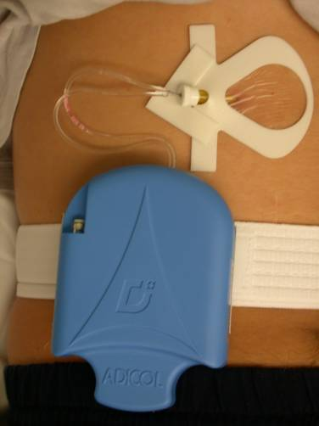
ADICOL Project –Disetronic / Roche
Inserted into the subcutaneous adipose tissue
Double lumen catheter
Acquires glucose readings every 30 minutes
Goal – subcutaneous glucose sensing/insulin delivery system

Slide 34
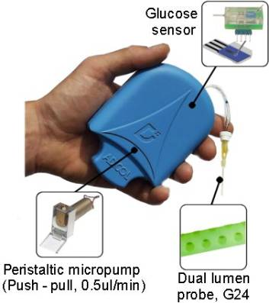
ADICOL Project –Disetronic / Roche
Large bore catheter
Readings only
every 30 minutes
Small study sample
with patient use

Slide 35
Infrared Spectroscopy
Animas Corporation Continuous Glucose Monitoring System

Slide 36
Infrared Spectroscopy
Infrared light is absorbed by molecules
Each molecule has its own spectra (absorption characteristic)—similar to its own footprint
Theoretically-by measuring the absorbed light vs. wavelength, one could delineate the species and concentration
In reality– this is difficult
Water absorbs most IR light
Blood scatters light
Different species overlap in their spectra or footprint

Slide 37
Spectra of Water, Hemoglobin, Blood & Glucose
Absorbance
0.042
0.040
0.038
0.036
0.034
0.032
Hemoglobin
0.030
0.028
0.026
0.024
0.022
0.020
0.018
0.016
0.014
0.012
0.010
0.008
0.006
0.004
1.2
1.3
1.4
1.5
1.6
1.7
1.8
1.9
2.0
2.1
2.2
2.3
Wavelength (microns)
Absorbance
0.062
0.060
Glucose
0.058
0.056
0.054
0.052
0.050
0.048
0.046
0.044
0.042
0.040
0.038
1.2
1.3
1.4
1.5
1.6
1.7
1.8
1.9
2.0
2.1
2.2
2.3
Wavelength (microns)

Slide 38
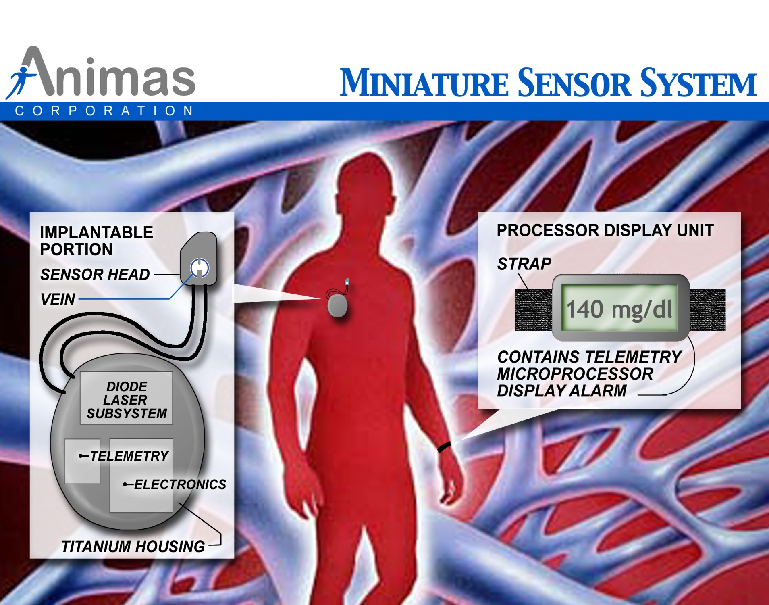

Slide 39
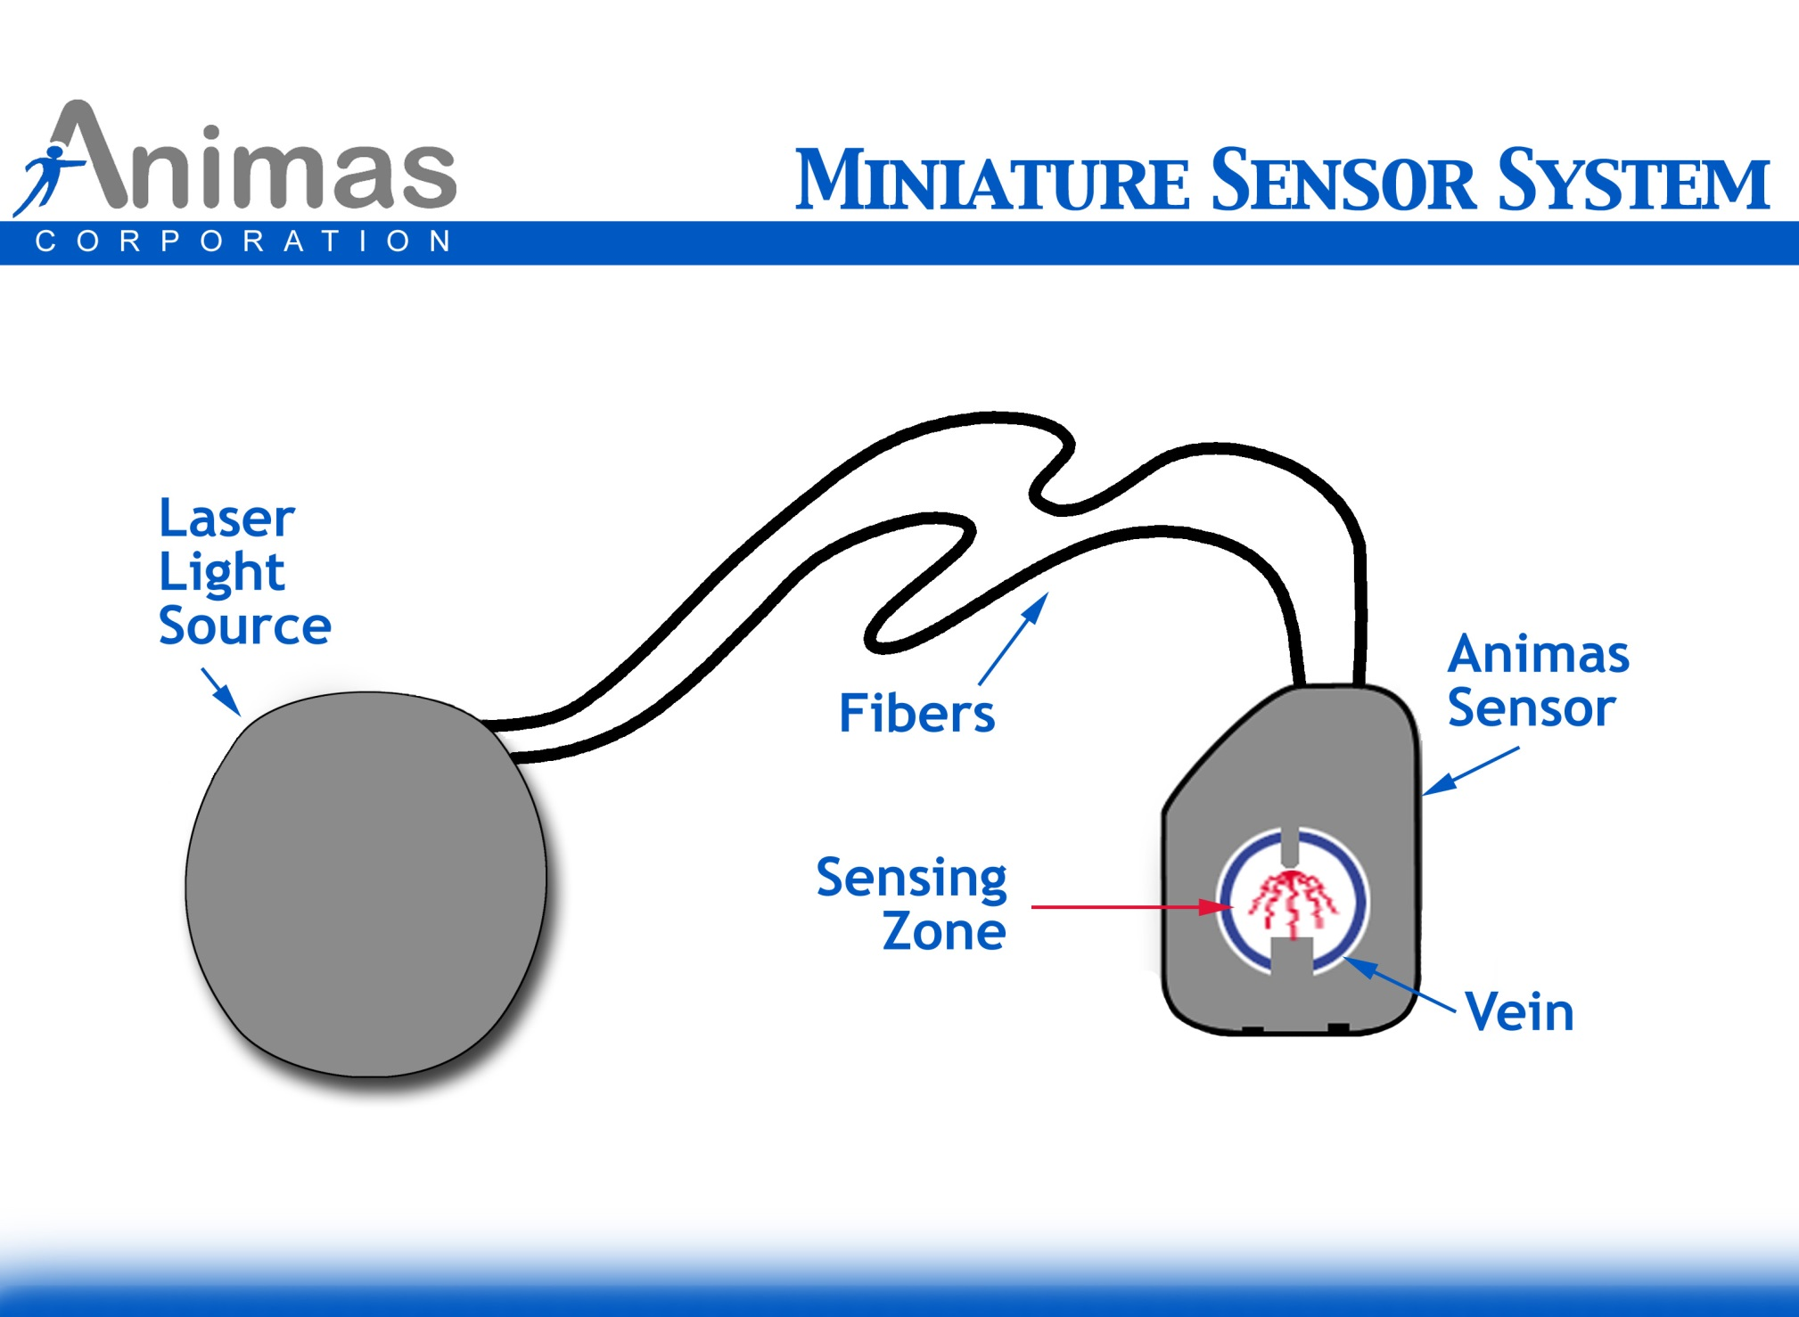
Sketch of Animas Sensor

Slide 40
Advantages of Animas Monitor
Provides continuous reading of blood glucose without patient intervention
Measures glucose in blood as opposed to some other body fluid, e.g. interstitial fluid, ocular fluid
The encapsulation/ fibrin tissue has no effect on monitor accuracy
Provides direct access to blood, obviating loss and interference associated with light transmission through intervening tissues.
Sensor stays implanted for at least 5 years, limited by battery life. No percutaneous wires or cables are utilized.

Slide 41
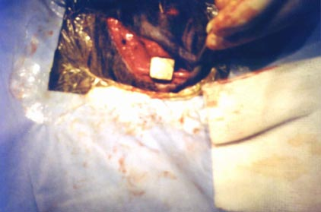
Implanted Extravascular Sensor Head

Slide 42
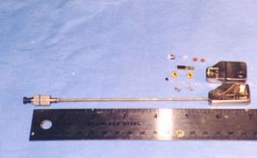
Early Animas Sensor Head

Slide 43
Correlation (r2=.94) between optical and conventional means (500 people)

Slide 44
Animas Continuous System
Has designed and built short term prototype and demonstrated stability in animals
Need to miniaturize system
Laser diodes under development
Telemetry developed
Electronics being modified and mostly developed
Clinical trials in humans started 2006. Projected as early Phase 2 studies with sites to be determined. No pediatric patients to be involved!
Product not yet on market

Slide 45
What is the Goal of These Technologies?
Development of a Closed Loop System– The Artificial Pancreas
*Put the Endocrinologist into
Early or Permanent Retirement

Slide 46
Have We Achieved Goal???
Not Yet!!

Slide 47
What Has Been Accomplished?
New Technology to determine patterns and facilitate changes in therapy
Prototypes for long term glucose monitoring
More awareness by patients and families regarding the importance of intensive therapy and “tight” control of blood glucoses
“Consumer driven” research for an artificial pancreas
More physicians are implementing intensive therapy with technology now available to compliment the treatment

Slide 48
Final Thoughts
No system at present is appropriate for a closed loop system
No system developed at present can replace the “finger stick” monitor for “real time” glucose values and treatment decisions
Presently, there are 50+ companies or individuals attempting to develop a continuous glucose monitoring system
EVENTUALLY, THAT DAY WILL ARRIVE!! WHEN, ONE ONLY KNOWS!
CAN WE AT IIT BOMBAY DO THIS??

